Slide 1
Brexit
What does it really mean for trade marks,
designs and patents?
Andy King and Kate O’Rourke
December 2020

Slide 2

Introduction
Focusing mainly on the impact on TM rights.
  Significant overlap between trade marks and designs.
  Little change is expected for patents.
Combining our own thoughts with guidance and commentary from:
  The UK IPO, the EUIPO, WIPO and The Chartered Institute of Trade Mark Attorneys (CITMA).
Some details are unfortunately still not 100% resolved.
Email any questions to: webinar@mewburn.com.
Please MUTE and turn video off.
Use Zoom chat to raise any technical issues.

Slide 3
The impact on trade mark rights post-Brexit
(1 January 2021)
webinar@mewburn.com

Slide 4
What happens to registered EUTMs and protected IR(EU)s?
webinar@mewburn.com

Slide 5
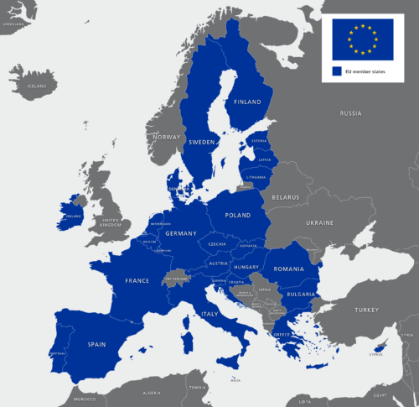
Cessation of protection of EUTMs in the UK
On Exit Day, granted EUTMs and protected EU designations will no longer cover the territory of the UK.
  The remaining EUTM / EU designation continues to protect the rest of the EU (27 Member States) only.
webinar@mewburn.com

Slide 6
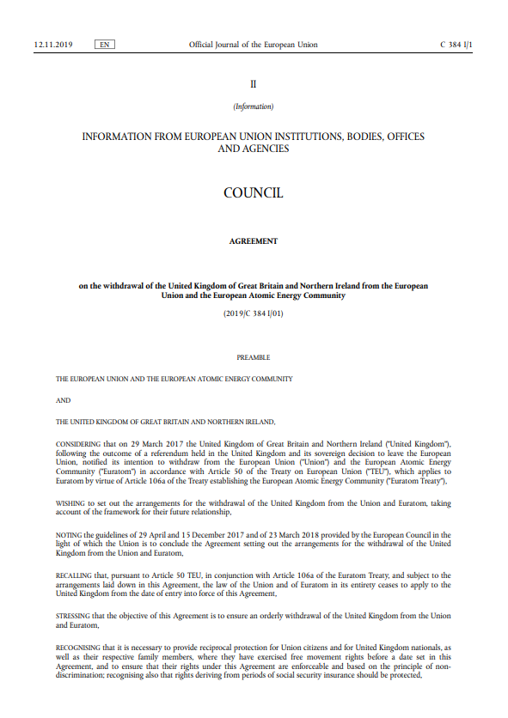
The Withdrawal Agreement ensures continued protection of IP rights
UK trade mark rights will be created from granted EUTMs and protected IR(EU)s (‘EU rights’) at the end of the transition period under the IP provisions of the Withdrawal Agreement.
  Where registration has granted (for EUTMs) or the ‘Statement of Grant of Protection’ has been issued by the EUIPO by 31 December 2020 for IR(EU)s.
Providing legal certainty and protecting the interests of rights-holders.
webinar@mewburn.com

Slide 7


A ‘comparable’ UK registration will be automatically cloned on Exit Day
A new UK national trade mark registration, identical to the EU right.
  Including the filing date (or the date of subsequent designation if applicable) and any priority claim / date.
    Any priority claim inherited from an EU right will have legal effect where proceedings involve a comparable UK right.
Recorded on the UK Trade Marks Register.
  Not as a new UK designation under the International Registration for IR(EU)s.
In practice, a simple database migration that has already been trialled by the UK IPO.
webinar@mewburn.com

Slide 8
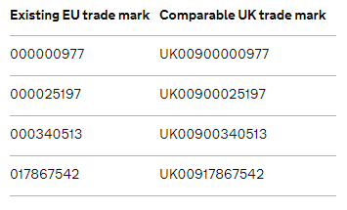
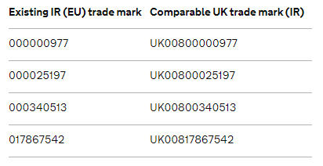
How will these new UK rights be identified?
The last 8 digits of the EUTM prefixed with ‘UK009’ for granted EUTMs.
  Distinguishable from ‘normal’ UK registrations.
  A link to the “parent” EUTM registration.
The last 8 digits of the international trade mark prefixed with ‘UK008’ for IR(EU)s.
webinar@mewburn.com

Slide 9
Other points to note about the ‘comparable’ UK registration
No re-examination.
No cost to the owner of the right.
Owners are not required to file any application form or to undertake any particular administrative procedure in the United Kingdom.
No UK registration certificate will issue.
  But details will be available on the UK IPO online register.
webinar@mewburn.com

Slide 10
Other points to note about the ‘comparable’ UK registration
It will be treated as if it had been registered under UK law.
Independent from the EU right.
  It can be challenged, assigned, licenced and renewed separately from the original EU right.
Owners of comparable UK registrations will not be required to have a correspondence address in the UK for the 3 years following the end of the transition period.
  It is understood that the EEA representative will be copied over from the parent EU right (where one has been appointed).
webinar@mewburn.com

Slide 11
Basic principles regarding the renewal date of the comparable UK right
The first renewal date for comparable UK marks derived from EUTMs will be the same as the renewal date of the corresponding EU right.
The renewal date for comparable marks that come from an IR(EU) will depend on when the EU was designated:
  If the EU was designated at the outset of the IR, the first renewal date for comparable UK marks will be the existing renewal date of the corresponding IR.
  But if the IR(EU) was subsequent designation, the comparable mark will adopt the date of that subsequent designation for the purpose of future renewal.
webinar@mewburn.com

Slide 12
What if the comparable UK right isn’t wanted?
webinar@mewburn.com

Slide 13
Opting out of the comparable right
Trade mark owners who do not wish to retain trade mark protection in the UK via the UK comparable trade mark are able to opt out, e.g.:
  An agreement that prohibits the ownership of a UK registration; or
  If there is already a corresponding UK designation of an International Registration.
But opting out is only possible after ‘Exit Day’ from 1 January 2021.
  After the comparable rights have been created on the UK Register.
  Any opt out requests made before then will not be valid, as they will have no subject.
Partial opt out, for example for some classes only, does not appear to be possible.
If the owner opts out, the UK comparable right will be treated as if it had never been filed or registered under UK law.
webinar@mewburn.com

Slide 14

How will opting out work?
The UK IPO will provide a ‘opt out’ notice template or official form after Exit Day.
  Multiple opt outs can be filed on a single form.
No official deadline or fee for opting out.
By law, notice to any third parties that have an interest in the mark (for example, licensees) must be given for opt out to have effect.
  The owner must confirm that such action has been taken.
  Likely to be in the form of a declaration on the official UK IPO form used to opt out.
webinar@mewburn.com

Slide 15
However, opting out may not be possible in some circumstances
Opting out of the comparable right is not available if:
  The mark has been used in the UK.
  The mark is subject to an assignment, licence or agreement.
  The mark is subject to litigation.
If the UK IPO determines that an opt-out right has been exercised in circumstances where it was not permitted, the comparable UK trade mark may be reinstated if it was removed from the register.
webinar@mewburn.com

Slide 16
What about pending EUTM applications and IR(EU)s?
webinar@mewburn.com

Slide 17
What about pending EU rights as at Exit Day?
Owners will have a 9-month window to re-file (i.e. until 30 September 2021) as an identical national UK application
  Preserving the filing and priority date of the EU right (and any UK seniority claim).
    The UK application process will provide a way of recording priority and seniority dates.
  Covering identical or more restricted goods and services.
  The normal UK IPO filing fees will be due.
  The re-filed UK application will then be examined and prosecuted in the usual way.
The application number for such re-filed marks will not have a link to the associated EU right (as with the comparable UK marks).
webinar@mewburn.com

Slide 18
What about pending EU rights as at Exit Day?
Note that owners of IR(EU)s will not be able to re-file as a new IR(UK) under this scheme.
Applies to both designations of the EU made with the initial application for an IR and subsequent designations of the EU.
  The designation must be recorded in the International Register before the end of the transition period.
webinar@mewburn.com

Slide 19
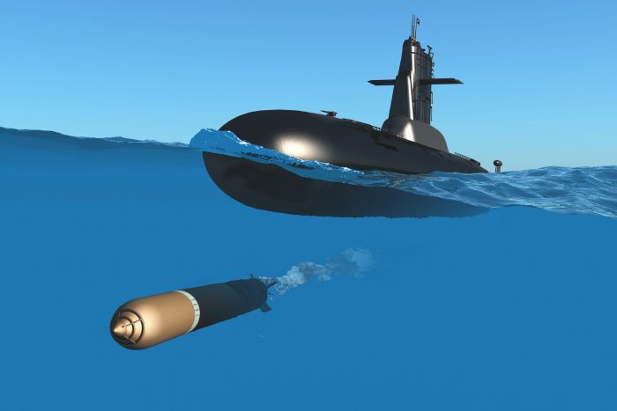
Be careful not to let any new UK applications be ‘torpedoed’
Does your client intend to file a UK trade mark application that does not correspond to a pending EUTM application in the 9 months after 1 January 2021?
  If so, beware that another party could subsequently file a UK application but claim the earlier date of a corresponding EU right that was pending on 1 January 2021.
  Where this happens, the later-filed UK application will take precedence.
Any pre-filing UK clearance searches should continue to look for EUTM applications pending on Exit Day, at least until 1 October 2021.
webinar@mewburn.com

Slide 20
Waiving our service fees when re-filing EU rights as UK applications
We are offering to re-file pending EU rights (EUTMs and IR(EU)s) as UK trade mark applications for free.
  “Free” means that we will not make a service charge to re-file the pending EU application, to file any forms at the UK IPO, or to record ourselves as the representatives.
  However, UK IPO official fees will still have to be paid at the point of re-filing, as will any costs further on.
The offer applies to any pending EU applications, regardless of whether Mewburn Ellis is already responsible for the case or not.
webinar@mewburn.com

Slide 21
What are the implications for inter partes IPO proceedings?
webinar@mewburn.com

Slide 22
What remains an earlier right in new proceedings after Exit Day?
From Exit Day, UK rights cannot be enforced against EU rights.
  A UK registration cannot be a basis for an opposition against an EUTM application.
  Any opposition or cancellation based solely on a UK right will be rejected.
Equally, EU rights cannot be enforced against UK rights.
  For UK proceedings initiated after 1 January 2021, EUTMs and IR(EU)s will no longer be considered valid earlier rights.
webinar@mewburn.com

Slide 23

The impact on ongoing opposition proceedings against EU rights
Pending EUIPO opposition proceedings against EUTMs / IR(EU)s that are based solely on earlier UK rights will be dismissed.
  Each party will be ordered to pay their own costs.
The opposition may have to be re-filed in the UK against any new UK application filed by the adversary.
We understand that this is being challenged and are monitoring the situation.
webinar@mewburn.com

Slide 24
What about ongoing opposition proceedings against UK rights?
Pending UK IPO opposition proceedings based on earlier EUTMs / IR(EU)s (granted and pending) will continue to be heard in line with the law applicable prior to Exit Day.
  The EU right will be treated as a valid earlier right until the proceedings conclude.
  However, actions/remedies taken or granted will only apply to the comparable UK right.
  New comparable UK rights, or re-filed UK applications cannot be substituted in.
We’re expecting the UK IPO to issue practice guidance shortly to confirm this situation.
webinar@mewburn.com

Slide 25
The situation is essentially the same for ongoing cancellations
Pending EU cancellation proceedings that are based solely on earlier UK rights will be dismissed.
  Each party will be ordered to pay their own costs.
  We understand that this is being challenged and are monitoring the situation.
UK cancellation actions based on earlier EUTMs or IR(EU)s will continue
  The law applicable prior to Exit Day applies.
  However, actions/remedies taken or granted will only apply to the comparable UK right.
webinar@mewburn.com

Slide 26
What happens if a granted EU right is under cancellation attack?
Comparable UK rights will still be created from EU rights that are the subject of ongoing cancellation proceedings at Exit Day.
  With a status of “registered – cancellation pending” on the UK Register.
But, if the parent EUTM is then cancelled in the EU as the result of an action that was ongoing on Exit Day, the comparable UK right will also to be cancelled to the same extent, with the same date of effect, upon notification to the UK IPO.
  This means that separate cancellation actions will not need to be launched against the comparable UK right after 1 January 2021.
However, the same is not true if the parent EU right is an IR(EU).
  The effect of the EU cancellation will not ‘flow through’ to the UK comparable mark.
webinar@mewburn.com

Slide 27
Ongoing cancellation proceedings against the parent EU right
However, the cancellation will not have effect on the comparable right if the grounds aren’t applicable in the UK.
  For example, if an absolute grounds cancellation is based on descriptiveness in Greek, or a relative grounds invalidity is based solely on Latvian earlier rights.
  In such circumstances, the proprietor will have to file a ‘Derogation Notice’ to explain to the UK IPO.
Despite the UK leaving the EU, descriptiveness examination under English will continue.
  There are remaining EU member states that have English as their national language, e.g. Republic of Ireland.
English will also remain one of the official languages of the EUIPO.
webinar@mewburn.com

Slide 28
Implications on the use of trade marks (non-use and reputation)
webinar@mewburn.com

Slide 29

Use to resist a non-use cancellation challenge against a comparable mark
A period of 5 years’ non-use in the UK can render a mark vulnerable to challenge.
However, many comparable UK marks created from EU rights will never have been used in the UK.
webinar@mewburn.com

Slide 30
Use to resist a non-use cancellation challenge against a comparable mark
Where the relevant 5-year period includes time before Exit Day, any genuine use of the mark in the EU before 1 January 2021 will count as qualifying use of the comparable UK right.
  Whether use is inside or outside the UK.
  The significance of this use will likely decrease over time, depending on the extent to which it covers the relevant five year period.
But where the period includes any time after 1 January 2021, use of the mark in the EU (and so outside of the UK) after that date will not be taken into account.
  Only use in the UK will then be relevant.
webinar@mewburn.com

Slide 31
The effect on a reputation that arises from use of a mark
An approach similar to the non-use position is being applied to the assessment of reputation in a comparable UK right.
  The reputation of the EU trade mark in the EU, but not necessarily in the UK, will be considered for the purposes of the comparable UK right.
  The owner of the comparable UK right can therefore exercise rights that arise from a reputation, for example in opposition or invalidity proceedings, if the reputation was acquired in the EU by the end of the transition period.
  As from Exit Day, the continuing reputation of a comparable UK right shall be based on the use of the mark in the United Kingdom.
Reputation of the EUTM or IR(EU) that is derived from use in the UK may be taken into account up until Exit Day.
  But not after Exit Day.
webinar@mewburn.com

Slide 32
The impact on representation
webinar@mewburn.com

Slide 33
Representation at the EUIPO
UK representatives can continue to represent their clients before the EUIPO in cases that are ongoing at the end of the transition period.
  This right of representation will continue for all stages of the procedure before the EUIPO, so including any appeal to the Boards of Appeal.
  This includes the prosecution of EU rights (and oppositions that may arise after Exit Day), as well as the handling of contentious matters such as oppositions or cancellations.
However, UK attorneys will be not be able to act on new matters/filings at the EUIPO after Exit Day.
webinar@mewburn.com

Slide 34
Continued EUIPO representation from Mewburn Ellis
We have had a fully-functioning office in Munich, Germany since 2017.
There are currently 16 people based in the office, three of whom are EUIPO representatives.
  Including Dydra Donath, a Trade Mark Partner of the firm.
Another EUIPO representative, Swetlana Frese, will be joining the firm on 1 December 2020 as a Senior Associate.
  Continuing to recruit for further trade mark attorneys.
Support on EUTM matters still provided by experienced UK attorneys.
This means that we are able to continue to represent clients at the EUIPO seamlessly.
webinar@mewburn.com

Slide 35
Representation at the UK IPO for comparable rights
Owners of UK registrations only need to appoint a UK IPO representative if based outside of the EEA.
  Currently, a representative only needs to be based within the EEA.
  Thus, an existing EUIPO representative for the ‘parent’ EU right will be sufficient for the comparable UK right, and will be automatically copied across.
  This will remain the case for three years (so until 31 December 2023).
  Also for UK re-registrations of RCDs.
Owners are nevertheless advised to consider if a representative located outside of the UK is suitably qualified and competent in UK trade mark law and practice to fully represent their interests.
  There may also be considerations relating to the scope of a firm’s professional indemnity insurance for handling matters outside of the firm’s jurisdiction.
webinar@mewburn.com

Slide 36
What happens if the EU right has no recorded EUIPO representative?
Owners of EUTMs and IR(EU)s must appoint an EUIPO representative for all proceedings at the Office, except filing and renewal.
If no issues are raised whilst the application or designation is pending, granted EU rights may have no recorded representative.
  For IR(EU)s, the WIPO representative is not recorded on the EUIPO file.
In such cases, the comparable UK right will have no representative.
  Official correspondence, including renewal reminders, will therefore be sent directly to the owner by the UK IPO, potentially by mail.
We therefore suggest that a UK IPO representative is appointed for these files as soon as possible after the 1 January 2021.
webinar@mewburn.com

Slide 37
Representation at the UK IPO for new ‘re-filed’ rights
There is however a distinction between the situation for the automatically-created comparable rights and new UK applications that are ‘re-filings’ of pending EU rights.
  Any new UK applications will need to have a representative in the UK, Isle of Man, Channel Islands or Gibraltar, where the applicant is not based in the UK.
webinar@mewburn.com

Slide 38
Other Related Issues and Practical Considerations
webinar@mewburn.com

Slide 39
Dual-filing of trade marks now recommended
Trade mark owners are advised to consider dual-filing in the UK and the EU, so that the applications can proceed together.
We continue to offer a 50% reduction to our usual service charges for filing a UK trade mark when instructed at the same time as an EU trade mark application.
  Valid until the end of the transition period on 31 December 2020.
  The 50% discount applies to our usual service charge for an identical UK trade mark application if this filing is instructed at the same time as the filing of the EU trade mark application.
  The 50% discount also applies to our extra class and priority claim service charges.
webinar@mewburn.com

Slide 40
What is the impact on registered designs
(RCDS)?
webinar@mewburn.com

Slide 41
The basic impact on registered design rights
RCDs and International (EU) designs will no longer cover the UK after 31 December 2020.
From 1 January 2021 onwards, anyone wanting to protect their designs through registration in both the EU and the UK will need to file separate RCD and UK registered design applications.
The national UK registered design rights regime will be unaffected by Brexit.
webinar@mewburn.com

Slide 42
The impact on RCDs is largely consistent with the position for EUTMs
Holders of granted Registered Community Designs (RCDs) and International (EU) Designs at 31 December 2020 will automatically be given a fully equivalent, independent UK right.
  No official cost and no forms will need to be filed.
  The UK registrations will retain the original filing, priority and seniority dates and the first renewal dates will be the same as the original EU registrations.
  Owners will be able to opt out, based on certain requirements.
Owners of pending RCD applications as at 31 December 2020 will have 9 months to reapply for the equivalent UK rights.
  The usual fees and forms will be required, but the original filing, priority and seniority dates will all be retained.
webinar@mewburn.com

Slide 43
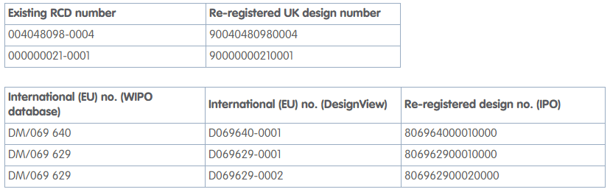
How will the new UK re-registered design rights be identified?
The numbering for UK re-registrations of RCDs will see the full 13-digit RCD number prefixed with the digit ‘9’.
UK re-registered rights based on protected International (EU) designs will consist of the full IR (EU) number prefixed with the digit ‘8’.
webinar@mewburn.com

Slide 44
Complications relating to RCDs with deferred publication
An RCD that is deferred on Exit Day will be treated as being equivalent to a pending application.
  The holder of a deferred RCD can preserve its earlier filing and priority dates in the UK by filing an equivalent registered design application within 9 months, just like pending applications.
  However, the application will not be the subject of a substantive examination, because the RCD has already been examined by EUIPO.
webinar@mewburn.com

Slide 45
The impact of Brexit on patents and SPCs
webinar@mewburn.com

Slide 46
What impact is there on patents?
We’re expecting there will be little that’s different for patents after Brexit.
  The European patent system will be unaffected by the UK leaving the EU.
  The European Patent Convention and the EPO are independent of the EU.
  The EPC has always had a number of non-EU members such as Switzerland, Norway and Turkey.
  No specific action from patent holders is therefore needed.
  UK-based European patent attorneys will continue to represent clients at the EPO.
webinar@mewburn.com

Slide 47
What is the impact on Supplementary Protection Certificates?
SPC protection in the UK will remain broadly unchanged following the end of the transition period.
  The UK government’s aim has been to retain the status quo.
The EU SPC Regulation, which was adopted into UK law in 2018, provides a maximum of 5 years additional protection based on the first marketing authorisation for the product in the EEA.
Pending applications for SPCs based on an EU regulation will continue and can be granted after the end of the transition period.
UK SPCs granted before the end of the transition period will remain in force after 1 January 2021, though then being governed by UK law.
webinar@mewburn.com

Slide 48
Take note of some key differences for UK SPCs
There are some potentially critical changes or nuances for UK holders of SPCs from 1 January 2021.
Key differences will be:
  An SPC in Great Britain must be based on a UK marketing authorisation granted by the MRHA; European Medicine Agency (EMA) authorisation will no longer be enough to warrant grant from 1 January 2021.
  The term of an SPC in Great Britain will be based on the earliest authorisation, in either the UK or the EEA.
  If a marketing authorisation in Great Britain is granted after a centralised EMA authorisation, the SPC term will still be calculated from the date of the centralised EU authorisation.
Contact us for more information on this and other changes to SPCs.
webinar@mewburn.com

Slide 49
Checklist: actions to take now
webinar@mewburn.com

Slide 50
What actions should be taken before the end of the transition period?
Review local representation of EU rights.
Consider instructing UK representatives for cloned UK rights.
Discuss opting out of the cloned UK TM and design rights with clients.
Dual-file for new applications in the UK and EU going forwards.
Understand new registration numbers for comparable UK rights and the impact on your systems.
Review impact on ongoing EUIPO opposition and cancellation proceedings.
For TMs, advise clients on the effect on non-use and reputation going forwards.
webinar@mewburn.com

Slide 51
What other actions should be taken before the end of the transition period?
Press clients for renewal instructions for EU rights that are due to expire before Exit Day.
  Also seek instructions for UK comparable rights that will expire soon after Exit Day.
Check the impact on any existing and pending commercial agreements, such as co-existence agreements.
  Any references to the EU in relation to territory, governing law and jurisdiction may need to be revised to specifically include the UK.
  Settlement or coexistence terms for any new agreement should anticipate the UK comparable right.
  Check that there are no limitations on ownership of a UK trade mark or design right that could be broken by the automatic comparable right.
Licences should be extended to cover the comparable UK registration (if appropriate).
webinar@mewburn.com

Slide 52
Please let us know if you want more information or have questions on…
Renewals
Seniority claims
Exhaustion
Conversion of EU rights
Enforcement at Court
Remedies / injunctions
Replacement of national marks by IR designations
Gibraltar, Guernsey, Jersey etc.
Restoration
Collective / certification marks
EU case law
Assignments
Licences and security interests
Multiple EU designations
Plant Variety Rights (PVRs)
webinar@mewburn.com

Slide 53
Any questions?
webinar@mewburn.com

